Slide 1

CMR INSTITUTE OF TECHNOLOGY
(UGC AUTUNOMOUS)
Approved by AICTE Permanently Affiliated to JNTU, Hyderabad,
Accredited by NBA and NACC with A+ Grade
Kandlakoya(V),Medchal Dist 501401
2024-2025
PERSONALIZED TRAVEL PLANNING
SYSTEM
CSM-B
Presented by
Batch 22:
A.Harsha Vardhan 22R01A66D0
K.Hathiram 22R01A66F5
M.Sharanya 22R01A66G6
Under the Guidance of
Mr.k.v.Bala Murali Krishna
Assistant Professor, CSE(AIML)

Slide 2

ABSTRACT
This project builds a personalized travel recommendation system using machine learning. It collects real tourist data, cleans it, selects important features, and uses a decision tree (C4.5 suggest destinations.
• Unlike older systems, this method improves accuracy, speed, and satisfaction. The goal is to
offer personalized recommendations without needing users’ travel history, making trip planning simple and fast.

Slide 3
INTRODUCTION
Choosing a travel destination has become increasingly difficult due to the overwhelming amount of information available online. Tourists often face confusion and decision fatigue when browsing through numerous websites, travel blogs, and user reviews, each offering conflicting or generic recommendations. As a result, the process of selecting a destination and creating an itinerary becomes time-consuming and inefficient.
To address this challenge, we propose a Personalized Travel Recommendation System that intelligently understands the unique preferences and needs of each tourist. Unlike traditional systems that rely on static filters or generic suggestions, our approach leverages real-world data, feature selection techniques, and Decision Tree algorithms to generate dynamic and tailored travel recommendations.

Slide 4
OBJECTIVE
A tourist destination from the information that is available on the Internet and through other sources is one of the most complex tasks for tourists when planning travel, both before and during travel. Previous Travel Recommendation Systems (TRSs) have attempted to solve this problem. However, some of the technical aspects such as system accuracy and the practical aspects such as usability and satisfaction have been neglected. To address this issue, it requires a full understanding of the tourists’ decision-making and novel models for their information search process.

Slide 5
EXISTING SYSTEM
Tourists often rely on online websites and mobile travel applications to search for travel destinations, accommodations, and activities. However, most of the traditional Travel Destination Recommendation Systems are limited in scope as they primarily focus on static information and basic user preferences, such as budget, location, or duration. These systems generally fail to adapt to dynamic user behavior or real-time contextual data like weather conditions, seasonal variations, local events, or last-minute changes in plans.

Slide 6
DISADVANTAGES
.They do not select important factors carefully.
•They cannot offer highly personalized recommendations.
•They need a lot of user past data to give good results.
•Accuracy of destination recommendations

Slide 7
PROPOSED SYSTEM
The proposed DM framework consists of four phases including data acquisition, data pre- processing, data analysis, and result interpretation. (1) For data acquisition, the designed questionnaire, which has four parts, is distributed and collected from Chiang Mai, Thailand. (2) The collected data is pre-processed using several data pre-processing techniques involving data cleaning, data transformation, and feature selection methods. (3) The third phase involves the data analysis processes using a decision tree C4.5 as classifier. The aim of the third phase is to identify suitable features and find personalized systems have not been a focus of RS research

Slide 8
ALGORITHMS
Decision Tree Algorithm
To classify and recommend destinations based on multiple user attributes like budget, interests, season, and location.
K-Nearest Neighbors (KNN)
To find similar users or destinations based on historical preferences and suggest destinations accordingly.
Random Forest
An ensemble of decision trees to improve recommendation accuracy.
Naïve Bayes Classifier
To classify user preferences and suggest destinations based on probability.

Slide 9

MODEL DISCRIPTION
The Personalized Travel Planning System is designed to recommend travel destinations based on user preferences, contextual factors, and real-time data. The system integrates Machine Learning algorithms, user profiling, and data-driven filtering techniques to offer customized and accurate travel suggestions. Below is a detailed breakdown of the model components and workflow.

Slide 10
ADVANTAGES
. Highly personalized recommendations
Offers destination and itinerary suggestions tailored to the user’s interests, preferences, budget, travel history, and group type.
. Time-Saving and Convenient
Reduces the time spent browsing multiple websites or apps by providing a one-stop solution for all travel planning needs.
. Improved Accuracy
uses machine learning algorithms like decision Trees and KNN to deliver accurate and revelant destination suggestions

Slide 11
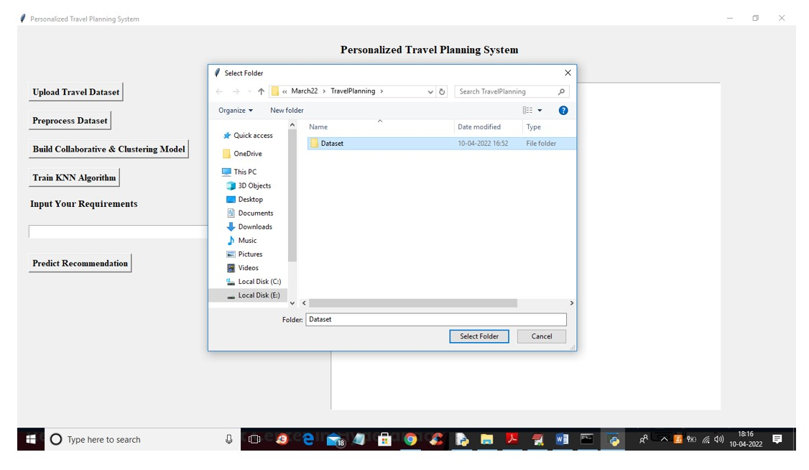
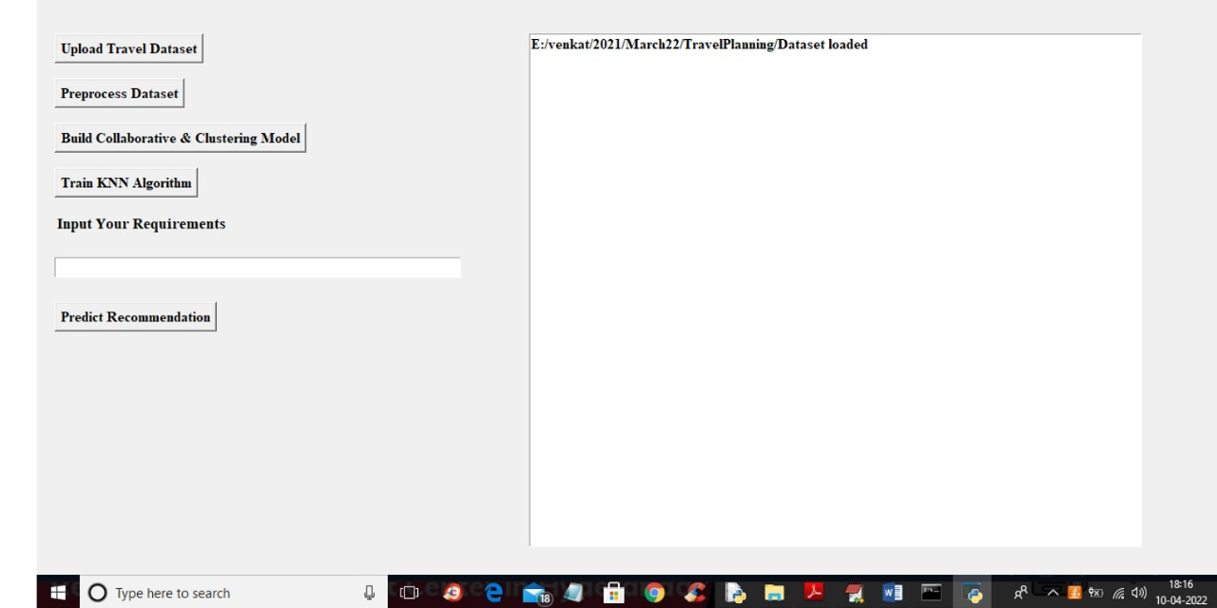
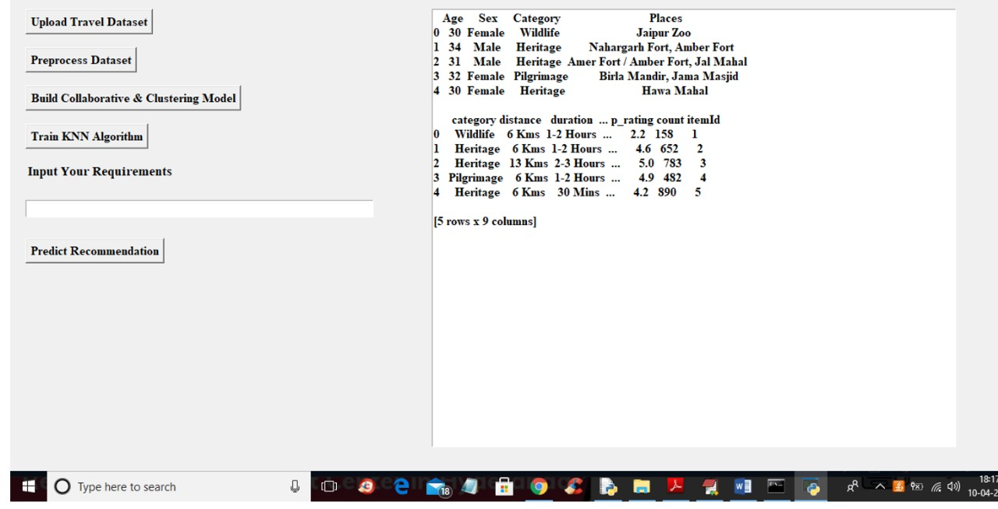
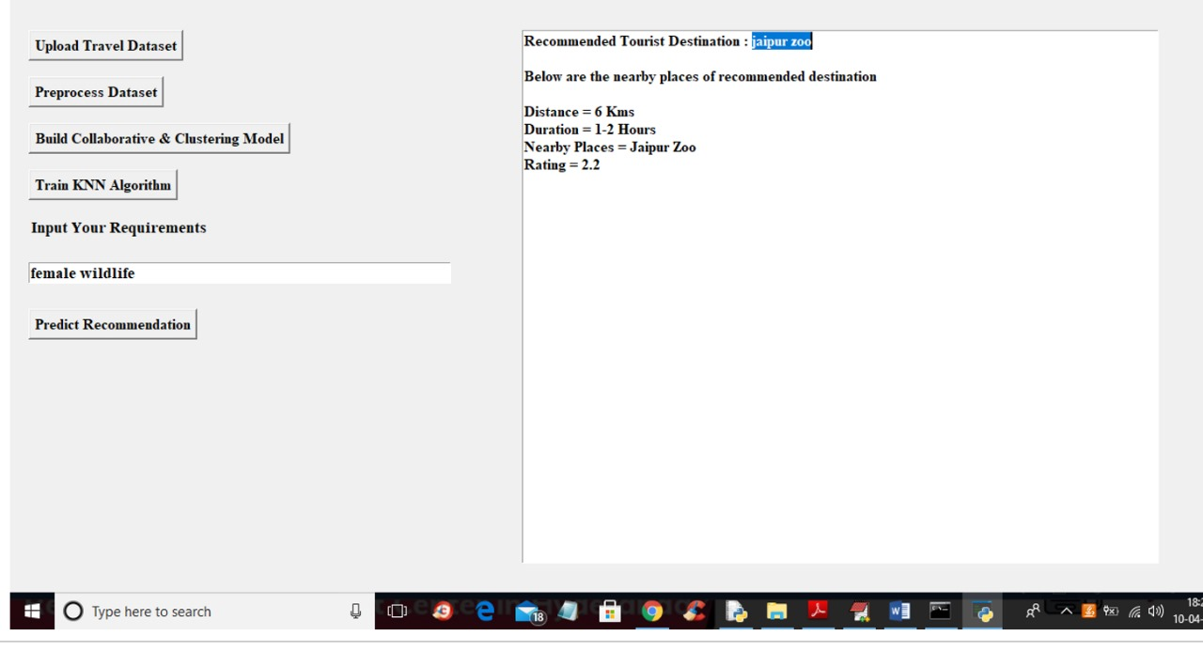
RESULT

Slide 12

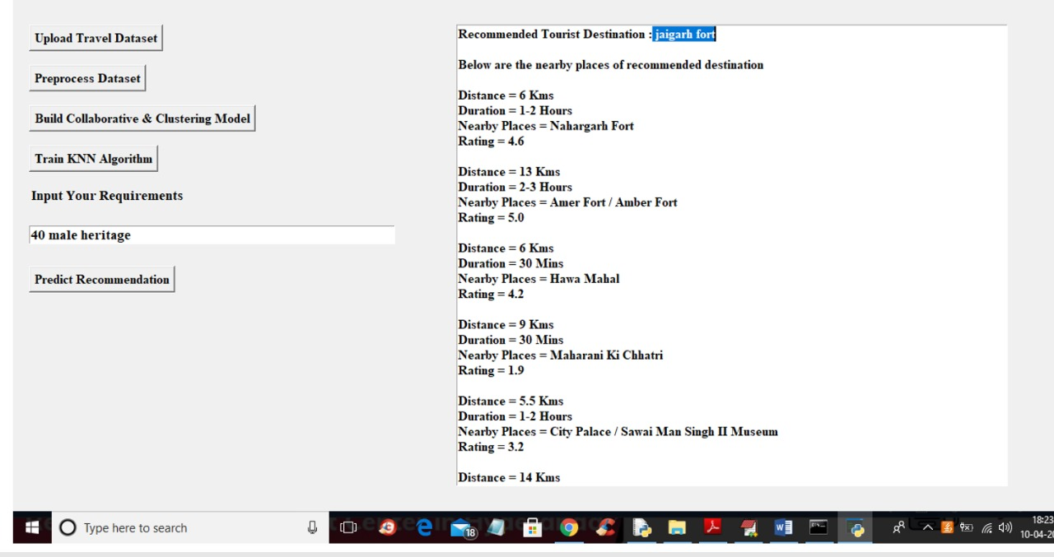
RESULT

Slide 13
Output form

Slide 14
CONCLUSION
a decision tree based tourist recommendation system has been presented in attempt of solving the current challenge of the destination TRS. The data set has been decomposed into two sub data sets using relevant tourism domain knowledge. This was done to increase classification accuracy rate and to reduce the complexity of the decision tree. The optimal decision trees from NMIFS with the highest accuracy rate and simplicity (i.e. less number of leaf and tree size) have been constructed for destination choice. The decision rules from decision trees were extracted. It can be seen that NMIFS is the optimum method because it uses fewer number of feature than MRMR for both of the data sets.

Slide 15
Further Enhancements
Integration with booking platforms
Add APIs from hotel, flight, train, and bus services (e.g., MakeMyTrip, Booking.com, IRCTC) to allow direct booking from within the system.
Voice based search and Assistance
Implement voice assistants using NLP (e.g., Google Speech API) for hands-free destination search and itinerary generation.
Chatbot Support
Include a smart chatbot to answer user queries and provide destination suggestions in real time, improving interaction and engagement.
Multi language support
Enhance accessibility for users by supporting multiple regional and global languages (e.g., Hindi, Telugu, Spanish, etc.).

Slide 16
REFERENCES
1. J.Chiverton, “Helmet Presence Classification with Motorcycle Detection And Tracking”,IET Intelligent Transport Systems,Vol. 6, Issue 3, pp. 259–269, March 2012.
2. Rattapoom Waranusast, Nannaphat Bundon, Vasan Timtong and Chainarong Tangnoi, “Machine Vision techniques for Motorcycle Safety Helmet Detection”, 28th International Conference on Image and Vision Computing New Zealand, pp 35-40, IVCNZ 2013.
3. Romuere Silva, Kelson Aires, Thiago Santos, Kalyf Abdala, Rodrigo Veras, Andr ́e Soares, “Automatic Detection Of Motorcyclists without Helmet”, 2013 XXXIX Latin America Computing Conference (CLEI).IEEE,2013.
4. Romuere Silva, “Helmet Detection on Motorcyclists Using Image Descriptors and Classifiers”, 27th SIBGRAPI Conference on Graphics, Patterns and Images.IEEE, 2014.
5. Thepnimit Marayatr, Pinit Kumhom, “Motorcyclist‟s Helmet Wearing Detection Using Image Processing”, Advanced Materials Research Vol 931- 932,pp. 588-592,May-2014.

Slide 17
THANK YOU!

